Slide 1
Investment Portfolio modeling with Markov Chains
John lee and Trever Komeiji
April 26, 2022

Slide 2
Background/Objective
In finance, portfolio managers must determine which and how much of a stock to purchase, balancing returns and risk. They do so through a variety of fundamental analysis and modeling techniques.
Inspired by a past project done by Jimmy Brunette, “Markov Chain Modeling for Stock Market Sector Performance”, we chose to model the market using a Monte Carlo Markov Simulation.
Our goal is to take a universe of stocks, perform a Monte Carlo Markov simulation over a period of time, and compute a page rank of how much of each stock we should purchase.
Using the page rank, we can compute theoretical P/L , as well as a Sharpe, which is a measurement of risk.

Slide 3
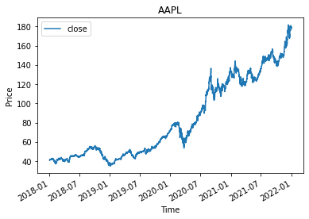
Dataset
Closing prices of stocks from 4 different sectors (Oil, Tech, Financial, Healthcare) with 3 stocks each, was collected hourly from 1/1/18 to 1/1/2022.
Data was truncated so only data from 9 - 4 (7 hours a day) remained and missing data was forward filled.
The log returns from each discrete time period was computed and served as the basis for computing states and transitions
Each Dataset was split 30/70, into train and test sets and the test set was split again into periods of 140 hours (~1 month) each.

Slide 4
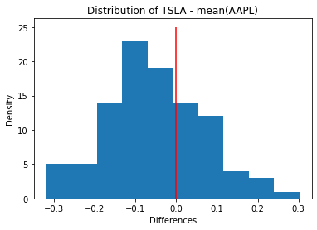
Models/Page Rank
Models | States
Control | Bull/Bear
Thresholding | Bull/Bear: [0.1%, 0.2%, 0.5%, >0.5%]
Time-Dependent | For each day (0-4) and hour (9-16), a Bull/Bear is computed
3 Models (Left)
Compute a simulation on each period of 140 hours for ~ X periods. (Forecasting 1 month at a time to avoid error propagation).
Computing Page Rank:
For each row (tickers) of the probability matrix, take the distribution of returns for that ticker (Left), and subtract the mean of the distribution for another ticker.
Compute the probability of a positive value, so (right of red line / total)
This Model is relevant because it allows an individual to determine proportions of stocks to purchase given a particular model.

Slide 5
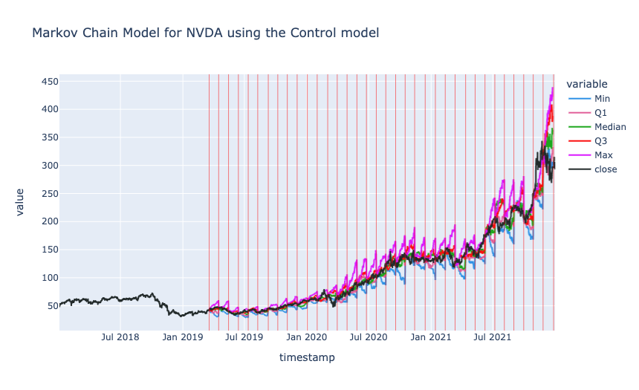
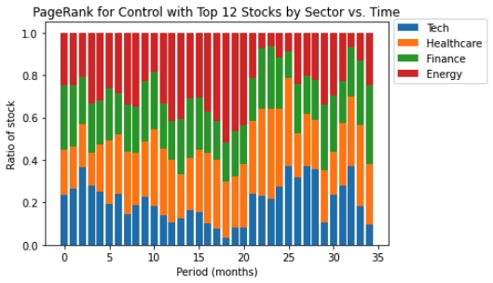
Model Results (simulation)
Markov Chain Model (Upper Right)
Each stock’s price was simulated
Actual Price Path generally fell between Max and Min
PageRank (Bottom Right)
Portfolio Allocation using PageRank
PageRank generally agreed when using different Markov Models

Slide 6
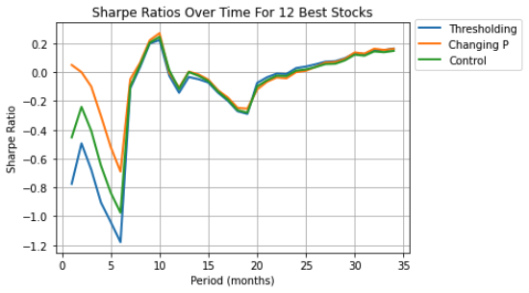
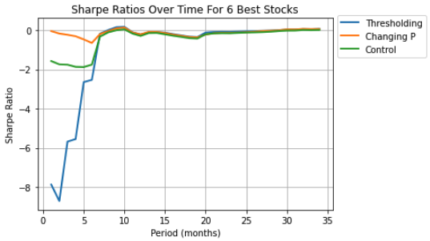
Model Results
Markov Chain Model | Number of Stocks | Total Returns
Control | 12 | 1.27
Thresholding | 12 | 1.33
Time-Dependent | 12 | 1.30
Control | 6 | 0.94
Thresholding | 6 | 1.06
Time-Dependent | 6 | 1.07
Sharpe Ratio (Far Left)
Indicator of how efficient a strategy is
Strategies with 12 stocks outperformed the strategies with 6 stocks
PnL (Left)
Measures profit or loss
Strategies with 12 stocks outperformed the strategies with 6 stocks

